Slide 1

Problem solving

Slide 2
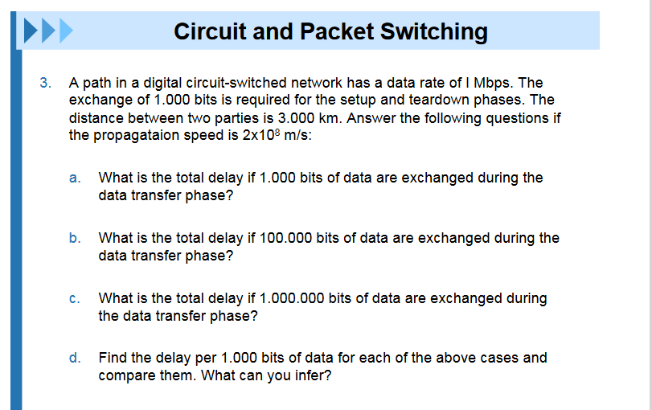
Q.N0.1

Slide 3
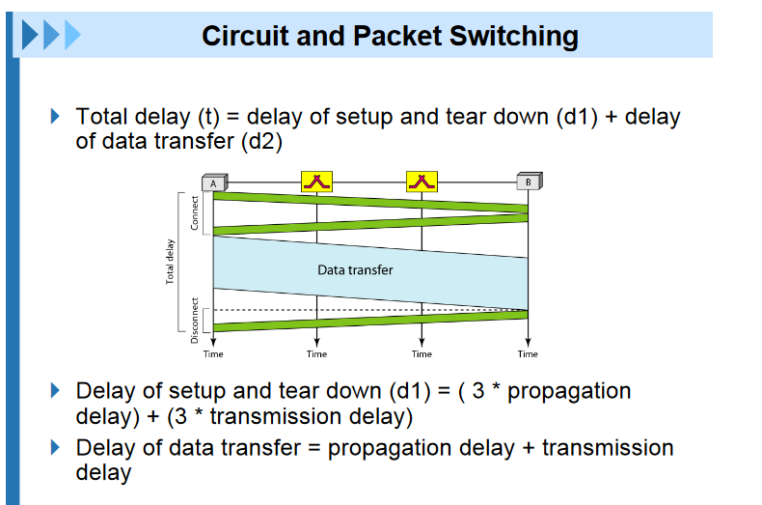
Solution

Slide 4
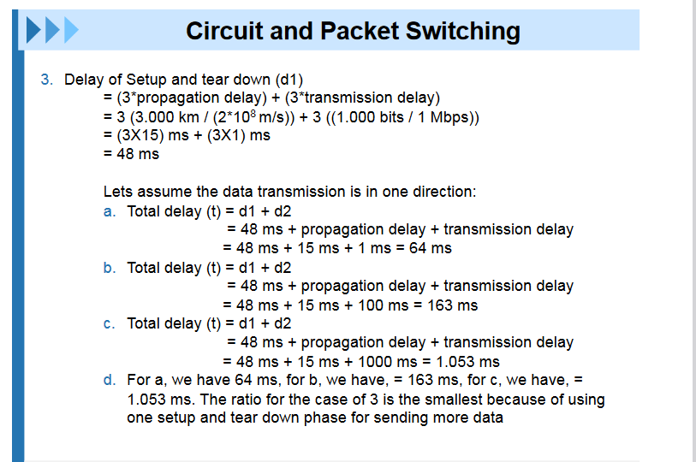

Slide 5
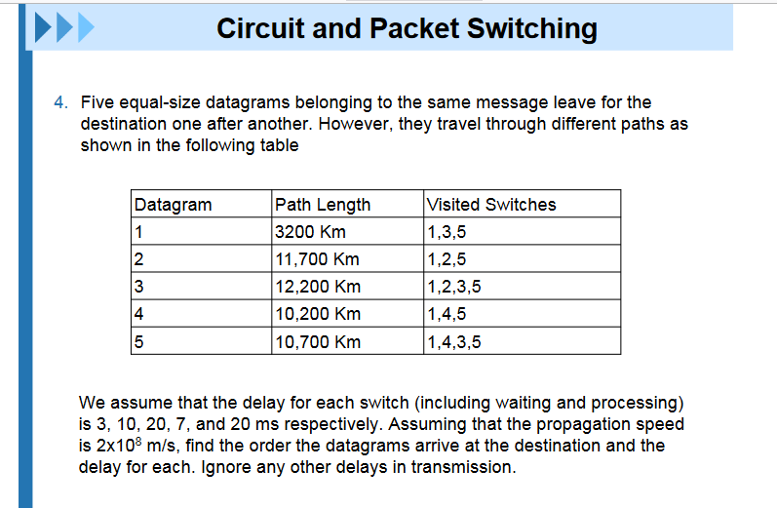
Q.No.2

Slide 6
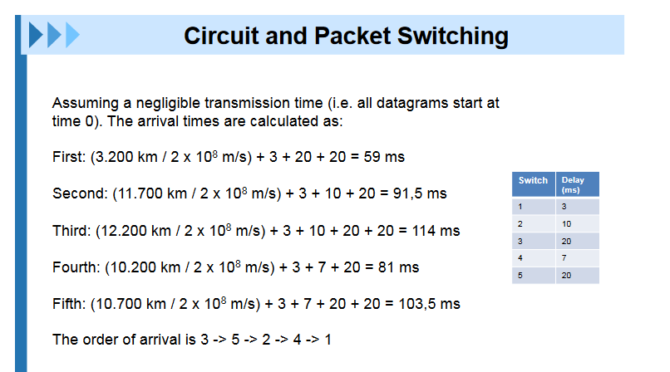
Solution

Slide 7
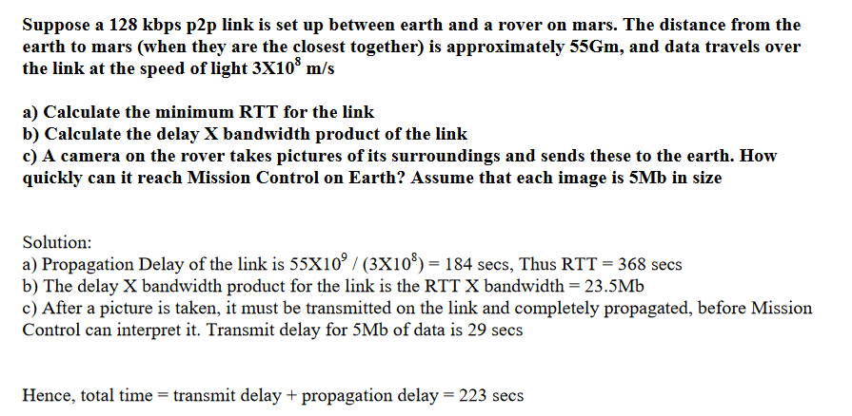
Q.No.3

Slide 8
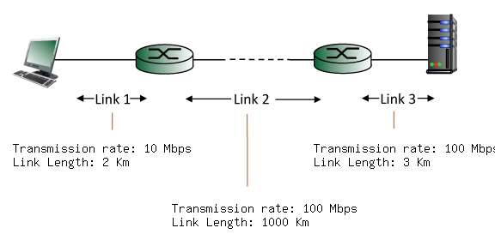
Q.No.4
Find the end-to-end delay (including the transmission delays and propagation delays on each of the three links, but ignoring queueing delays and processing delays) from when the left host begins transmitting the first bit of a packet to the time when the last bit of that packet is received at the server at the right. The speed of light propagation delay on each link is 3x10**8 m/sec. Note that the transmission rates are in Mbps and the link distances are in Km. Assume a packet length of 16000 bits. Give your answer in milliseconds.

Slide 9
Solution:
Link 1 transmission delay = L/R = 16000 bits / 10 Mbps = 1.600000 msec. Link 1 propagation delay = d/s = 2 Km / 3*10**8 m/sec = 0.006667 msec. Link 2 transmission delay = L/R = 16000 bits / 100 Mbps = 0.160000 msec. Link 2 propagation delay = d/s = 1000 Km / 3*10**8 m/sec = 3.333333 msec. Link 3 transmission delay = L/R = 16000 bits / 100 Mbps = 0.160000 msec. Link 3 propagation delay = d/s = 3 Km / 3*10**8 m/sec = 0.010000 msec. Thus, the total end-to-end delay is the sum of these six delays: 5.270000 msecs.

Slide 10
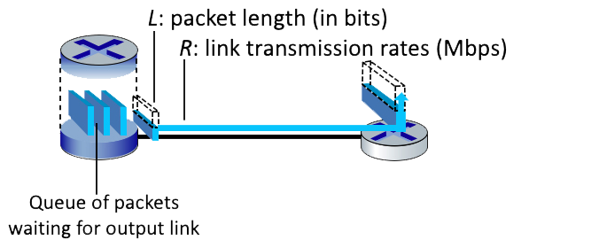
Q.No.5
Q1. Suppose that the packet length is L= 8000 bits, and that the link transmission rate along the link to router on the right is R = 1 Mbps. . What is the transmission delay? What is the maximum number of packets per second that can be transmitted by this link?
HThe transmission delay = L/R = 8000 bits / 1000000 bps = 0.008 seconds
The number of packets that can be transmitted in a second into the link = R / L = 1000000 bps / 8000 bits = 125 packets

Slide 11

Q6.A network with bandwidth of 10 Mbps can pass only an average of 12,000 frames per minute with each frame carrying an average of 10,000 bits. What is the throughput of this network?

Slide 12
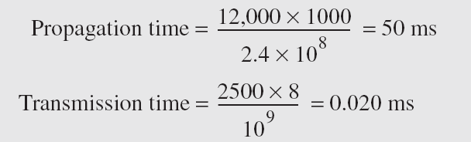
Q7.What are the propagation time and the transmission time for a 2.5-kbyte message (an e-mail) if the bandwidth of the network is 1 Gbps? Assume that the distance between the sender and the receiver is 12,000 km and that light travels at 2.4 × 108 m/s.
Solution
Propagation Delay = Distance/Propagation speed
Transmission Delay = Message size/bandwidth bps
Latency = Propagation delay + Transmission delay + Queueing time + Processing time

Slide 13
Q8. What are the propagation time and the transmission time for a 5-Mbyte message (an image) if the bandwidth of the network is 1 Mbps? Assume that the distance between the sender and the receiver is 12,000 km and that light travels at 2.4 × 10⁸ m/s.
Solution

Slide 14
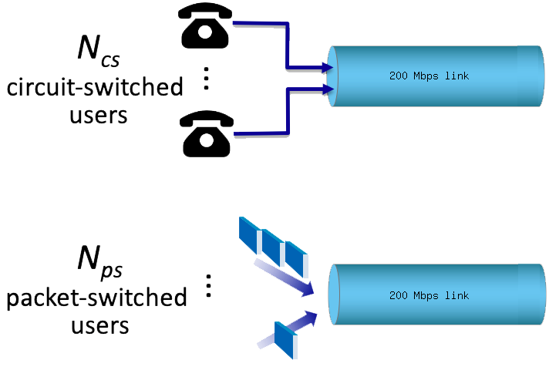
Q9. Consider the two scenarios below: A circuit-switching scenario in which N_{cs} users, each requiring a bandwidth of 20 Mbps, must share a link of capacity 200 Mbps. A packet-switching scenario with N_{ps} users(19) sharing a 200 Mbps link, where each user again requires 20 Mbps when transmitting, but only needs to transmit 20 percent of the time.

Slide 15
9a.When circuit switching is used, what is the maximum number of users that can be supported?
When circuit switching is used, what is the maximum number of users that can be supported? 1 user = 20Mbps Capacity=200Mbps Number of users = Total capacity/1 user =200/20 =10

Slide 16
9b.Suppose packet switching is used. What is the probability that a given (specific) user is transmitting, and the remaining users are not transmitting? Nps=19
The probability that a given user is transmitting is p=0.2 Probability that other user is not transmitting= (1-p)=0.8 Probability that all of the other N_{ps}-1 users are not transmitting = (1-p)^{N}_{ps}⁻¹. Thus the probability that one specific user is transmitting and the remaining users are not transmitting = p*(1-p)^{N}_{ps}⁻¹ =.0036

Slide 17

10.Suppose a signal travels through a transmission medium and its power is reduced to one-half. This means that P2 is (1/2)P1. In this case, the attenuation (loss of power) can be calculated as
A loss of 3 dB (–3 dB) is equivalent to losing one-half the power.

Slide 18
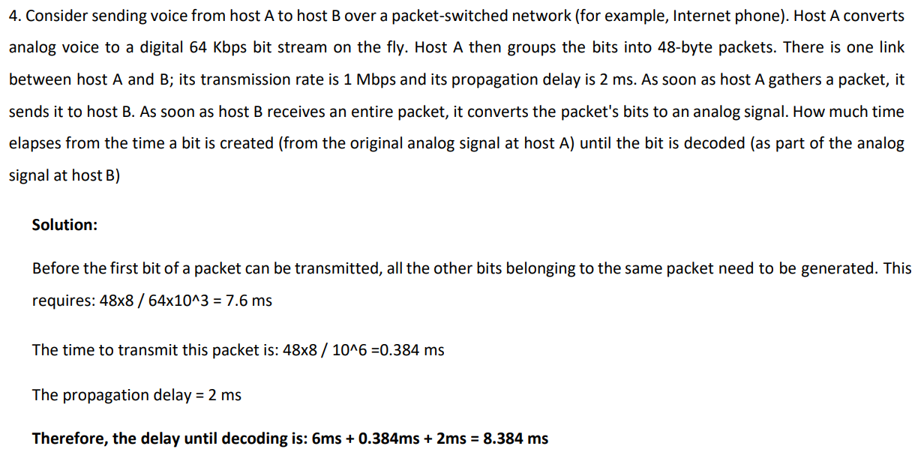
Question:11

Slide 19
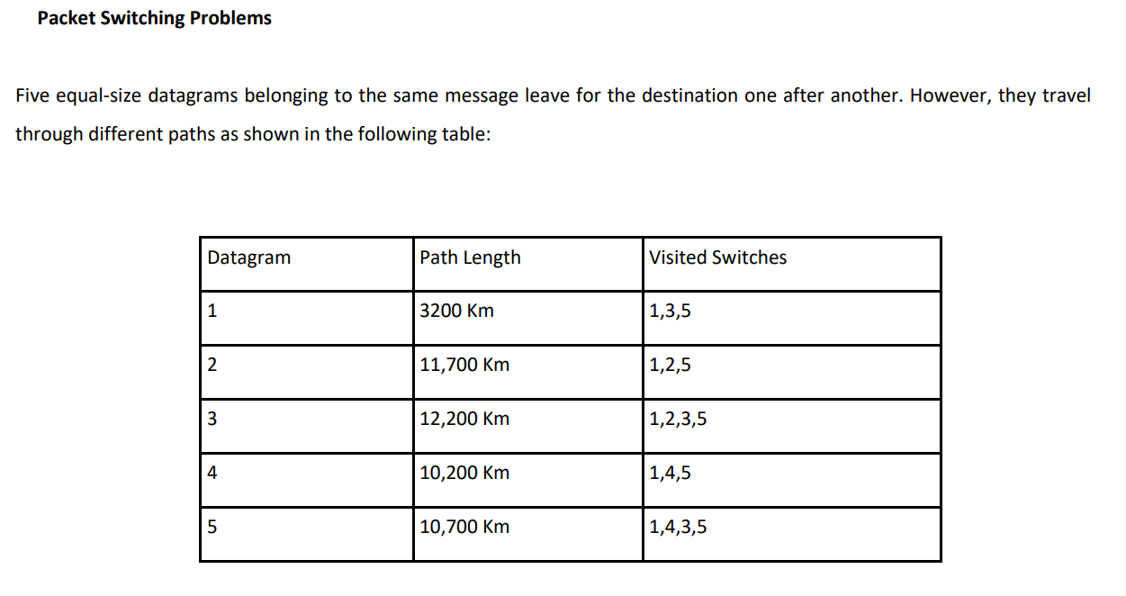
12.

Slide 20
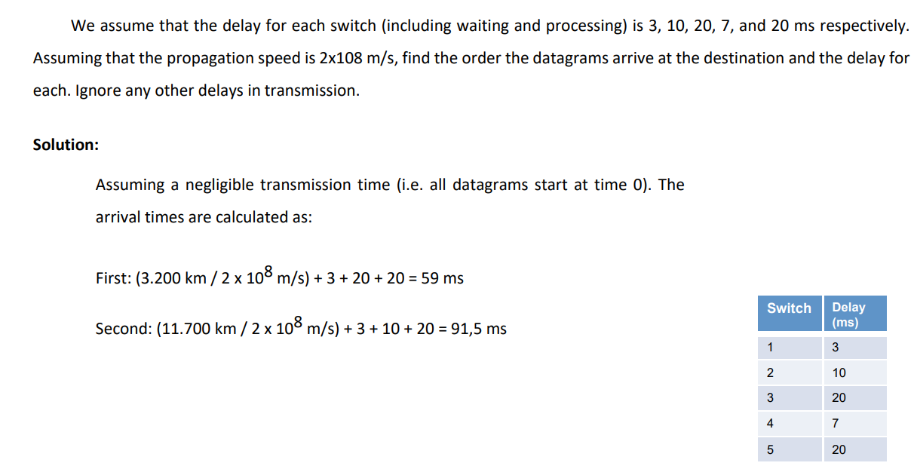
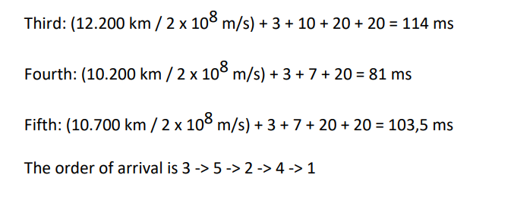

Slide 21
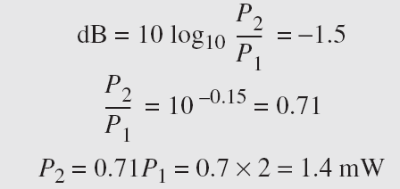
13.The loss in a cable is usually defined in decibels per kilometer (dB/km). If the signal at the beginning of a cable with −0.3 dB/km has a power of 2 mW, what is the power of the signal at 5 km?
Solution
The loss in the cable in decibels is 5 × (−0.3) = −1.5 dB. We can calculate the power as

Slide 22
14.Consider a noiseless channel with a bandwidth of 3000 Hz transmitting a signal with two signal levels. What is the maximum bit rate

Slide 23

Q15) Assume there is a network that transfers data using circuit switching. There are three switches between end-users (sender and receiver) on this network, with a channel capacity (bandwidth) of 10 Mbps. Calculate the total time it takes to send a 100-byte message from sender to recipient using the information below (Consider the given parameters according to the requirement).
The propagation speed is estimated to be 2.4 * 10^8 m/s.
The hop distance between two nodes is 12,000 kilometres.
The header is 100 bytes long.
The circuit setup time is 10 seconds, and the circuit disconnect time is half that of the setup time.
Answer q1:
There are three switches between end-users (sender and receiver)
Number of hops=4
Bandwidth (BW)=10Mbps=10×10⁶bits/sec =10⁷bits/sec
Message Size (M)=100bytes=10×8=800 bits
speed (S)= 2.4 * 10^8 m/s.
Distance (D)= 12,000 kilometres= 12000×1000 meters
Circuit Connection set up time=10 sec
Circuit disconnect/termination time= 5sec
Transmission delay= M/BW=Tt=MBw
Tt=800 bits10⁷ Bits/sec=8×10⁻⁵ sec
Propagation delay Tp=DistanceSpeed
Tp=12000*103 meters2.54*103mesters/sec=5×10⁻² sec
Total time= Connection set up time + Transmission delay + (Propagation delay * Number of hops) + Tear down time
Total time= 10+8×10⁻⁵ +(5×10⁻² ×4)+5= 15.20008 sec =15200.08 ms=15200080 micro sec

